Slide 1
软件工程案例分析与实践
Rational Unified Process
概述

Slide 2
Outline
Introduction to RUP
Implementing Best Practices
Phases, Iterations, Workflows and Activities
The Iteration Process in RUP
Planning a RUP Project
Tailoring and Implementing RUP
RUP vs. CMMI

Slide 3
What is RUP
Process Framework and a detailed prescriptive process model
  Meta Process / Must customize
Software engineering knowledge base
  Covers almost all activities of software development
Well defined structure for object-oriented design and development
  Based on OO and UML
Like a software product, the Rational Unified Process is designed and documented using the Unified Modeling Language (UML)
  Well documented

Slide 4
Rational统一过程( Rational Unified Process, RUP)
由Rational公司提出并维护，具有多功能性和广泛的适用性。
  生命周期：迭代与增量的二维生命周期结构
  人员：按“角色”进行划分
  方法：UML建模、基于用例驱动和以架构为中心的分析设计，并提供了一整套支持工具
  产品：工件

Slide 5
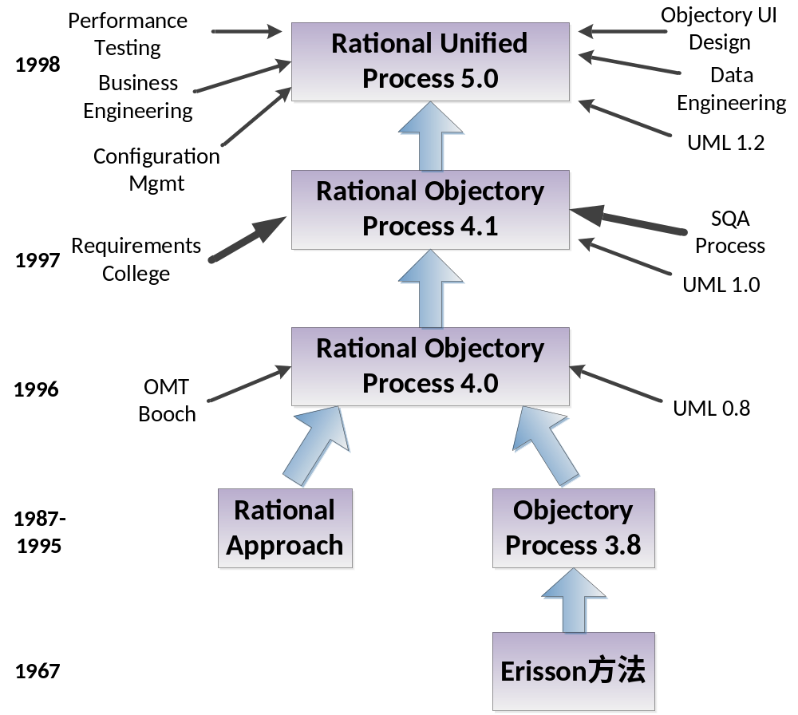
A Brief History of RUP

Slide 6
Outline
Introduction to RUP
Implementing Best Practices
Phases, Iterations, Workflows and Activities
The Iteration Process in RUP
Planning a RUP Project
Tailoring and Implementing RUP
RUP vs. CMMI

Slide 7
RUP开发经验（最佳实践）
迭代式开发 → 容纳需求变更/减少风险
管理需求 → 使用用例和脚本
使用基于构件的体系结构→ 功能清晰的模块和子系统
可视化建模→模型可为文字、图形、数学表达式
验证软件质量 → 质量评估内建在贯穿于整个开发过程的、由全体成员参与的所有活动中
控制软件变更→ 控制、跟踪、监控修改

Slide 8
Rational Unified Process
Describes the effective implementation of key “Best Practices”
Manage Requirements
Develop
Iteratively
Use
Component
Architectures
Model
Visually
Verify
Quality
Control Changes

Slide 9
1. Develop Software Iteratively
  An initial design will likely be flawed with respect to its key requirements
  Late-phase discovery of design defects results in costly over-runs and/or project cancellation
The time and money spent implementing a faulty design
are not recoverable

Slide 10
Waterfall Development
Requirements
Analysis
Design
Code & Unit
Testing
Subsystem
Testing
System Testing
T I M E

Slide 11
Waterfall Development:
Risk vs. Time
Requirements
Analysis
R
I
S
K
Design
Code & Unit
Testing
Subsystem
Testing
System Testing
T I M E

Slide 12

Iterative Development
Requirements
Analysis & Design
Planning
Initial
Planning
Management
Environment
Implementation
Deployment
Evaluation
Test
Each iteration results in an executable release

Slide 13
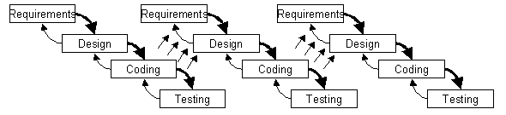
An Iterative Development Lifecycle

Slide 14
Risk Profile of an Iterative Development
Waterfall
Inception
Elaboration
RISK Reduction
Construction
Risk
Transition
Preliminary
Iteration
Architect.
Iteration
Architect.
Iteration
Devel.
Iteration
Devel.
Iteration
Devel.
Iteration
Transition
Iteration
Transition
Iteration
Post-
deployment
Time
Risks - process, technology, teamwork, customer, business domain

Slide 15
Iterative Development Characteristics
  Critical risks are resolved before making large investments
  Initial iterations enable early user feedback
  Testing and integration are continuous
  Objective milestones provide short-term focus
  Progress is measured by assessing implementations
  Partial implementations can be deployed

Slide 16




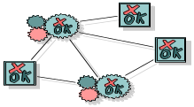
2. Manage Your Requirements
Elicit, organize, and document required functionality and constraints
Track and document tradeoffs and decisions
Business requirements are easily captured and communicated through use cases
Use cases are important planning instruments
Use-Case Model
realization
influenced by
verifies
Use Cases drives the work from analysis through test
Design Model
Implementation Model
Test Model

Slide 17

3. Employ Component-based Architecture
Design, implement and test your architecture up-front!
A systematic approach to define a “good” architecture
  resilient to change by using well-defined interfaces
  by using and reverse engineering components
  derived from top rank use cases
  intuitively understandable
Application-
specific
Business-
specific
Component-based Architecture with layers
Middleware
System-
software

Slide 18




4. Model Software Visually
Capture the structure and behavior of architectures and components
Show how the elements of the system fit together
Maintain consistency between a design and its implementation
Promote unambiguous communication
Sub Systems
Visual Modeling
raises the level
of abstraction
Classes
Code

Slide 19

5. Verify Software Quality
Create tests for each key scenario to ensure that all requirements are properly implemented
Unacceptable application performance hurts as much as unacceptable reliability
Verify software reliability - memory leaks, bottle necks
Test every iteration - automate test!
Cost
Software problems
are 100 to 1000 times
more costly to find
and repair after deployment
Development Deployment

Slide 20


6. Control Changes to Software
Control, track and monitor changes to enable iterative development
Establish secure workspaces for each developer
  Provide isolation from changes made in other workspaces
  Control all software artifacts - models, code, docs, etc.
Automate integration and build management
Workspace
Management
Parallel
Development
CM is more than just check-in and check-out
Process
Integration
REPORT
Build
Management
ALERT

Slide 21

Rational Unified Process
Provides guidelines, templates and tool mentors for the effective implementation of key best practices
Delivered through a web-enabled searchable knowledge base
Manage Requirements
Develop
Iteratively
Verify
Quality
Use
Component
Architectures
Model
Visually
Control Changes

Slide 22
Outline
Introduction to RUP
Implementing Best Practices
Phases, Iterations, Workflows and Activities
The Iteration Process in RUP
Planning a RUP Project
Tailoring and Implementing RUP
RUP vs. CMMI

Slide 23
RUP 术语（一）
1. 用户（user）：用户代表与所开发的系统进行交互的某个人或某个系统。
2. 用例（use case）：能够向用户提供有价值的结果的一项系统功能。“用例驱动”
3. 架构（architecture）：系统在其所处的环境中最高层次的概念。软件系统的架构是指通过接口交互的重要构件的组织和结构。“以架构为中心”
4. 工作流程（workflow）：在业务中执行的活动序列，它相对于业务主角个体生成一个可见值结果。
5. 角色（worker）：在软件过程组织的环境中，个人或协同工作的小组的行为和职责定义为角色。

Slide 24
RUP 术语（二）
6. 迭代（iteration）与增量（increment）：
  迭代是阶段中的一个子项目，其结果是生成系统的一个内部或外部的发布版本。
  增量是指在后续迭代结束后，两个发布版本之间存在的差异或差值。
  “迭代和增量的过程”
7. 活动（activity）：是要求角色执行的工作单元。
8. 工件（artifacts）：是一条信息，有三个特性：由过程生成、修改和使用；定义了职责范围；受到版本控制。
9. 阶段（phase）和里程碑（milestone）
  里程碑是迭代正式结束的时间点。
  阶段是项目中相邻两个主要里程碑之间的时间段，在此期间要实现一组既定的目标、完成工件并决定是否进入下一阶段。

Slide 25
Process Notation
Describes a piece of work a worker may be asked to perform.
Activity
Worker
Signifies a role that may be played by an individual or a team of individuals in the development organization
Use-Case
Describe a
Use Case
Specifier
responsible for
Artifact
Signifies a piece of information that is produced, modified, or used by a process
Use Case
Use-Case
Package

Slide 26

Workers Are Used for Resource Planning
R
e
s
o
u
r
c
e
W
o
r
k
e
r
A
c
t
i
v
i
t
i
e
s
P
a
u
l
D
e
s
i
g
n
e
r
D
e
f
i
n
e
O
p
e
r
a
t
i
o
n
s
.
.
.
M
a
r
y
U
s
e
-
C
a
s
e
S
p
e
c
i
f
i
e
r
D
e
s
c
r
i
b
e
a
U
s
e
C
a
s
e
.
.
.
J
o
e
U
s
e
-
C
a
s
e
D
e
s
i
g
n
e
r
D
i
s
t
r
i
b
u
t
e
B
e
h
a
v
i
o
r
.
.
.
S
y
l
v
i
a
D
e
s
i
g
n
R
e
v
i
e
w
e
r
R
e
v
i
e
w
U
s
e
-
C
a
s
e
M
o
d
e
l
.
.
.
S
t
e
f
a
n
A
r
c
h
i
t
e
c
t
D
e
f
i
n
e
U
s
e
-
C
a
s
e
V
i
e
w
D
e
f
i
n
e
L
o
g
i
c
a
l
V
i
e
w
.
.
.
Each individual in the project is assigned to one or several workers

Slide 27
The RUP Life Cycle
Time
Phases
Process Workflows
Inception
Elaboration
Construction
Transition
Business Modeling
Requirements
Analysis & Design
Content
Implementation
Test
Deployment
Supporting Workflows
Configuration Mgmt
Management
Environment
Preliminary
Iteration(s)
Iter.
#1
Iter.
#2
Iter.
#n
Iter.
#n+1
Iter.
#n+2
Iter.
#m
Iter.
#m+1
Iterations

Slide 28
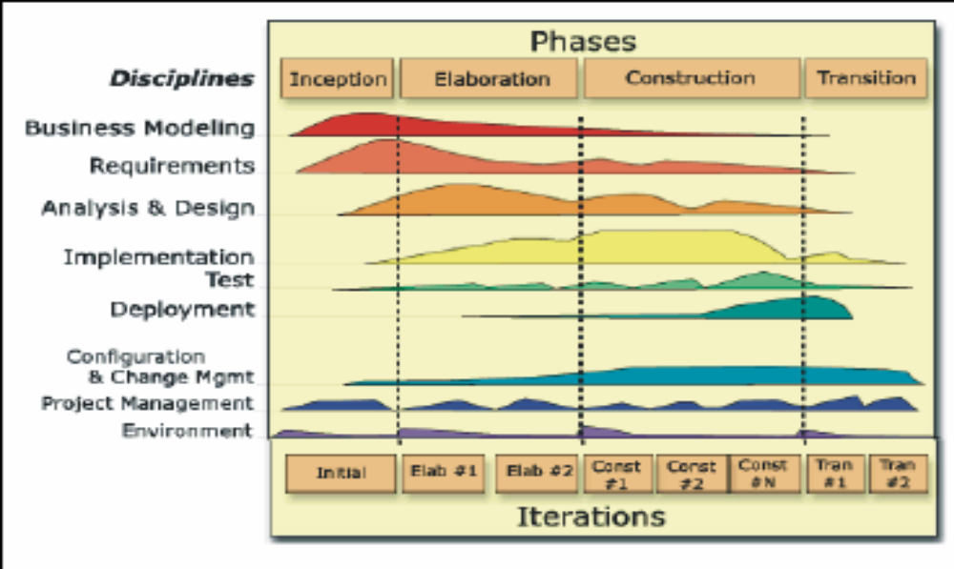
RUP软件开发生命周期（二维生命周期结构）
阶段
工作流
初始
精化
构建
移交
业务建模
需求
分析与设计
实现
测试
部署
配置与变更管理
项目管理
环境
初始
精化1
精化2
构建1
构建2
构建3
移交1
移交2

Slide 29
Phases and Iterations ——
The Time Dimension
Major
Milestones
Inception
Elaboration
Construction
Transition
time
The Rational Unified Process has four phases:
  Inception - Define the scope of project
  Elaboration - Plan project, specify features, baseline architecture
  Construction - Build the product
  Transition - Transition the product into end user community

Slide 30
生命周期的动态结构——四个阶段
初始阶段（Inception）：建立商业案例和确定项目的范围——生命周期目标里程碑
  Outcome
    A general vision of the project’s requirements, i.e., the core requirements
      Initial use-case model and domain model (10-20% complete)
    An initial business case, including:
      Success criteria (e.g., revenue projection收入预测)
      An initial risk assessment
      An estimate of resources required

Slide 31
生命周期的动态结构——四个阶段
  评审标准：
    主要项目干系人对系统的范围达成一致意见；
    对是否已经获得正确的需求集达成一致意见，并且对这些需求的理解是共同的；
    对成本/进度估算、优先级、风险和开发流程达成一致意见；
    已经确定所有风险并且有针对每个风险的风险降低策略。

Slide 32
生命周期的动态结构——四个阶段
精化阶段（Elaboration）：分析问题领域、建立稳定的架构、编制项目计划和淘汰项目中风险最高的元素——生命周期架构里程碑
  Outcome
    Use-case and domain model 80% complete
    An executable architecture and accompanying documentation
    A revised business case, incl. revised risk assessment
    A development plan for the overall project

Slide 33
生命周期的动态结构——四个阶段
  评审标准
    产品前景和需求是稳定的；
    架构是稳定的；
    可执行原型表明已经找到了主要的风险元素，并且已得到妥善解决；
    构建阶段的迭代计划足够详细和真实，可以保证工作继续进行；
    构建阶段的迭代计划有可靠的估算支持；
    所有项目干系人一致认为，如果在当前架构环境中执行当前计划来开发完整的系统，则当前的前景可以实现；
    实际的资源耗费与计划的耗费相比是可以接受的。

Slide 34
生命周期的动态结构——四个阶段
构建阶段（Construction）：所有构件和应用程序功能被开发并集成为产品，所有的功能被详尽地测试——初始可操作性能里程碑
  Products
    A complete use-case and design model
    Executable releases of increasing functionality
    User documentation
    Deployment documentation
    Evaluation criteria for each iteration
    Release descriptions, including quality assurance results
    Updated development plan

Slide 35
生命周期的动态结构——四个阶段
  评审标准：
    该产品发布版已经足够稳定和成熟，可部署在用户群中；
    所有项目干系人已准备好将产品发布到用户群；
    实际的资源耗费与计划相比仍可以接受。

Slide 36
生命周期的动态结构——四个阶段
移交阶段（Transition）：将软件产品交付给用户群体——产品发布里程碑
  Products
    Executable releases
    Updated system models
    Evaluation criteria for each iteration
    Release descriptions, including quality assurance results
    Updated user manuals
    Updated deployment documentation
    “Post-mortem” analysis of project performance
  评审标准：
    用户满意；
    实际的资源耗费与计划的耗费相比可以接受。

Slide 37
Resource Needs
Resources
More up-front effort for difficult projects
65%
10%
20%
5%
Time
Inception
10%
Elaboration
30%
Construction
50%
Transition
10%

Slide 38
Iterations
Minor Milestones:
Releases
Inception
Elaboration
Construction
Transition
Preliminary
Iteration
Architect.
Iteration
Architect.
Iteration
Devel.
Iteration
Devel.
Iteration
Devel.
Iteration
Transition
Iteration
Transition
Iteration
Each phase in the RUP can be further broken down into iterations.
An iteration is a complete development loop resulting in a release (internal or external) of an executable product, a subset of the final product under development, which grows incrementally from iteration to iteration to become the final system.

Slide 39
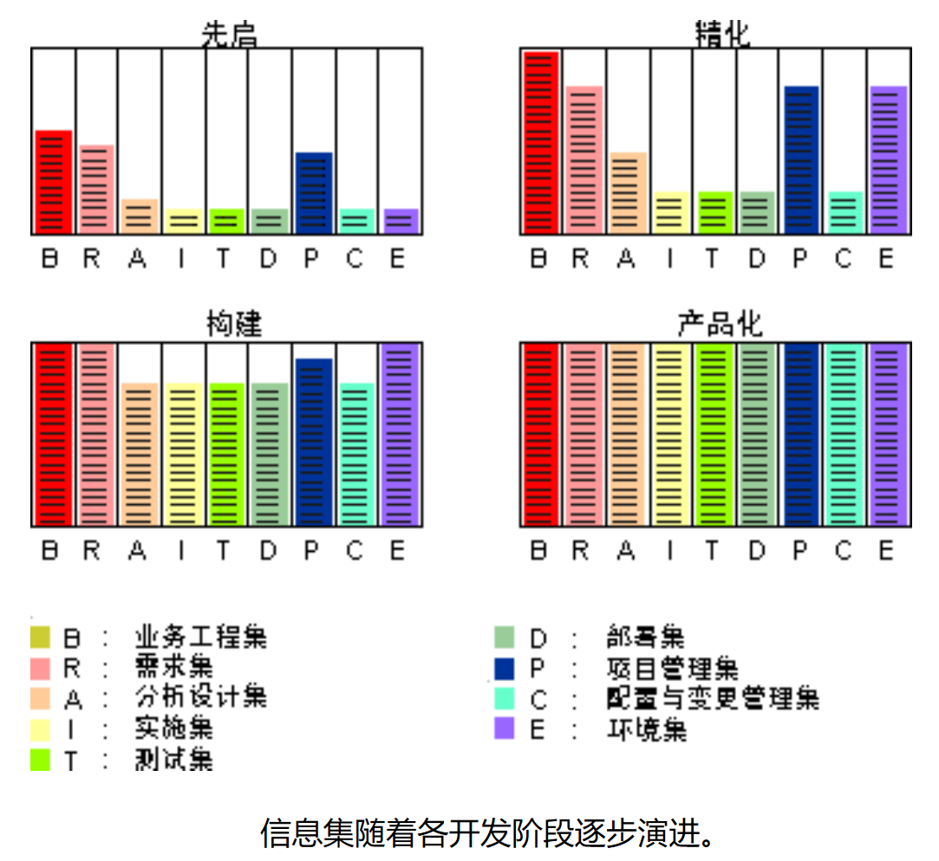

Slide 40
RUP生命周期的特点
与螺旋模型相比
  相似：重复一系列组成系统生命周期的循环；
  差异：
    RUP给出了每个阶段内的若干次迭代过程完成后交付的增量的具体要求，即 四个阶段的里程碑；
    RUP详细阐述了不同阶段的不同迭代过程经历的九大核心工作流程中活动内容的重点和强度不同；
    RUP提供了对每次迭代过程中不同核心工作流程活动的并行化支持；
  优点：用于指导需求不明确、不稳定的项目开发时具有更强的可操作性。

Slide 41
RUP生命周期的特点
与瀑布模型相比
  优点：
    RUP将成本风险进一步降低为获得一次增量所需的费用；
    RUP进一步降低了产品不能按计划投放市场的风险；
    RUP使项目开发更能适应项目需求的变化。

Slide 42
生命周期的静态结构——九个工作流
A workflow is a sequence of activities that produces a result of observable value.
There are 9 workflows, which represent a partitioning of all workers and activities into logical groupings
  6 engineering workflows:
    Business modeling
    Requirements
    Analysis & Design
    Implementation
    Test
    Deployment
  3 supporting workflows:
    Project management
    Configuration and Change Management
    Environment

Slide 43
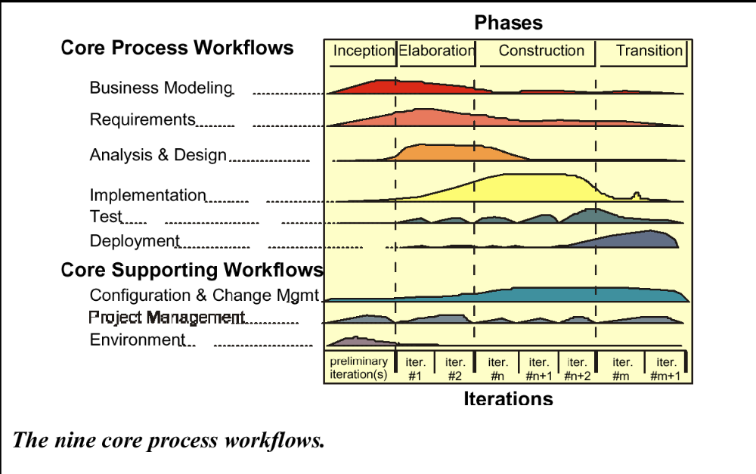
RUP 工作流

Slide 44

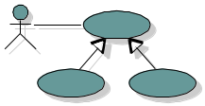

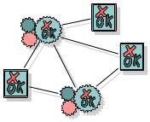
Models and Workflows
Each major workflow describes how to create and maintain a particular model
Business
Modeling
Business Model
Requirements
Workflow
realized by
Use-Case
Model
Analysis Design
Workflow
Design
Model
implemented by
Implementation
Workflow
verified by
Implementation
Model
Test Workflow
Test
Model

Slide 45


Bringing It All Together...
In an iteration, you walk through all workflows
Phases
Process Workflows
Inception
Elaboration
Construction
Transition
Business Modeling
Requirements
Analysis & Design
Implementation
Test
Deployment
Supporting Workflows
Configuration Mgmt
Management
Workflows group activities logically
Environment
Preliminary
Iteration(s)
Iter.
#1
Iter.
#2
Iter.
#n
Iter.
#n+1
Iter.
#n+2
Iter.
#m
Iter.
#m+1
Iterations

Slide 46
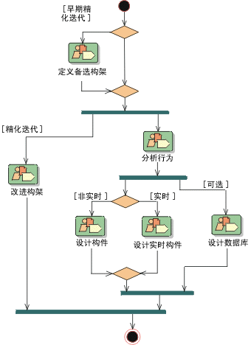
Example: The Analysis & Design Workflow

Slide 47
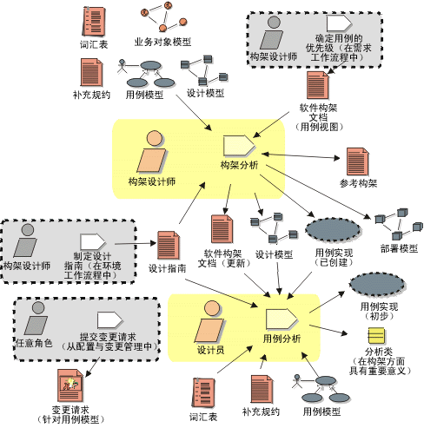
Workflow Detail: Define a Candidate Architecture

Slide 48
九个核心工作流
1. 业务建模：
  描述了如何拟定新目标组织的前景，并基于该前景来确定该组织在业务用例模型和业务对象模型中的流程、角色以及职责。
  主要角色：业务流程分析员、业务设计员、业务模型复审员
  主要工件：业务模型（包括业务用例模型和业务对象模型）
2. 需求：
  描述系统应该做什么，即捕获需求，并使开发人员和用户就这一需求描述达成共识。
  主要角色：系统分析员、用户界面设计员、需求复审员
  主要工件：用例模型和用户界面模型

Slide 49
九个核心工作流
3. 分析设计：
  将需求转化成对未来系统的设计，为系统开发一个健壮的结构，并调整设计使其与实现环境相匹配，优化其性能。
  主要角色：架构设计师、架构复审员、设计员、数据库设计员、设计复审员
  主要工件：设计模型和可选的分析模型
4. 实现：
  以层次化的子系统形式化地定义代码的组织结构；以构件的形式实现类和对象；将开发出的构件作为单元进行测试；将各实施人员（或团队）完成的结果集成到可执行系统中。
  主要角色：架构设计师、实施员、集成员、代码复审员
  主要工件：实现模型

Slide 50
九个核心工作流
5. 测试：
  检验对象间的交互作用，验证软件中所有构件是否正确集成，检验所有需求是否被正确的实现，识别、确认缺陷并确保在软件部署之前将缺陷解决。
  主要角色：测试设计员、测试员
  主要工件：测试模型和测试结果
6. 部署：
  成功地生成产品版本并将软件分发给最终用户。
  主要角色：部署经理、实施人员、技术文档编写员、培训开发员
  主要工件：产品的一个版本和文档培训资料

Slide 51
九个核心工作流
7. 配置和变更管理：
  描述了如何在多个成员组成的项目中控制大量的产品，并提供了相应准则来管理演化系统中的多个变体，跟踪软件创建过程中的版本变更；
  主要角色：配置经理、变更控制经理、集成员
  主要工件：配置管理计划、变更请求、项目存储库和工作区
8. 项目管理：
  平衡竞争的目标、管理风险并克服各种约束，从而成功交付使用户满意的产品；
  主要角色：项目经理、项目复审员
  主要工件：商业理由、迭代计划、风险管理计划、质量保证计划及相应的评估文档
9. 环境：
  向软件开发组织提供软件开发的环境，包括过程和工具；
  主要角色：过程工程师、工具专家
  主要工件：工作流程指南和工具、工具指南

Slide 52
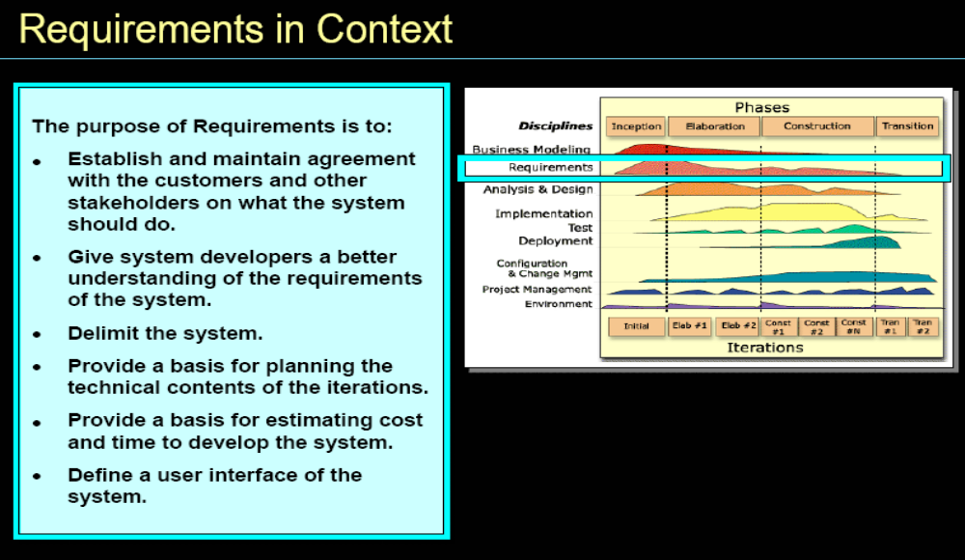

Slide 53
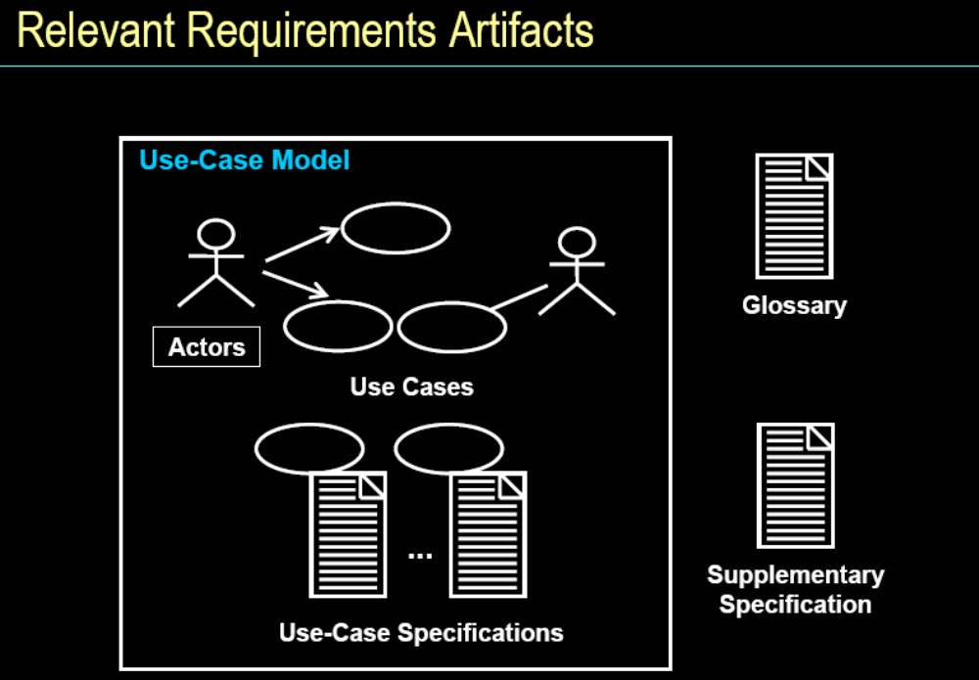

Slide 54
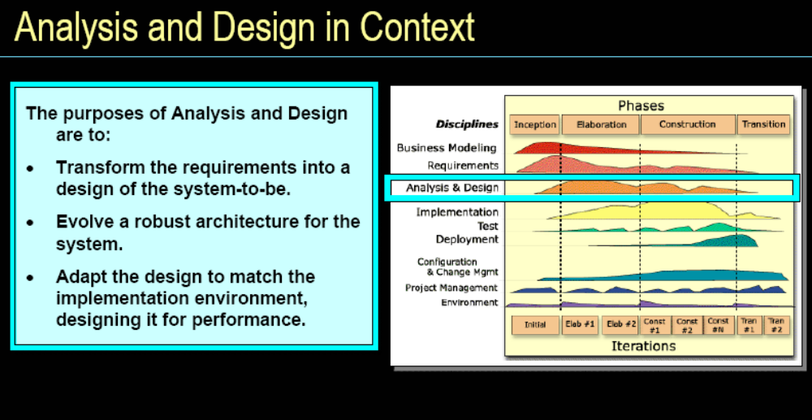

Slide 55
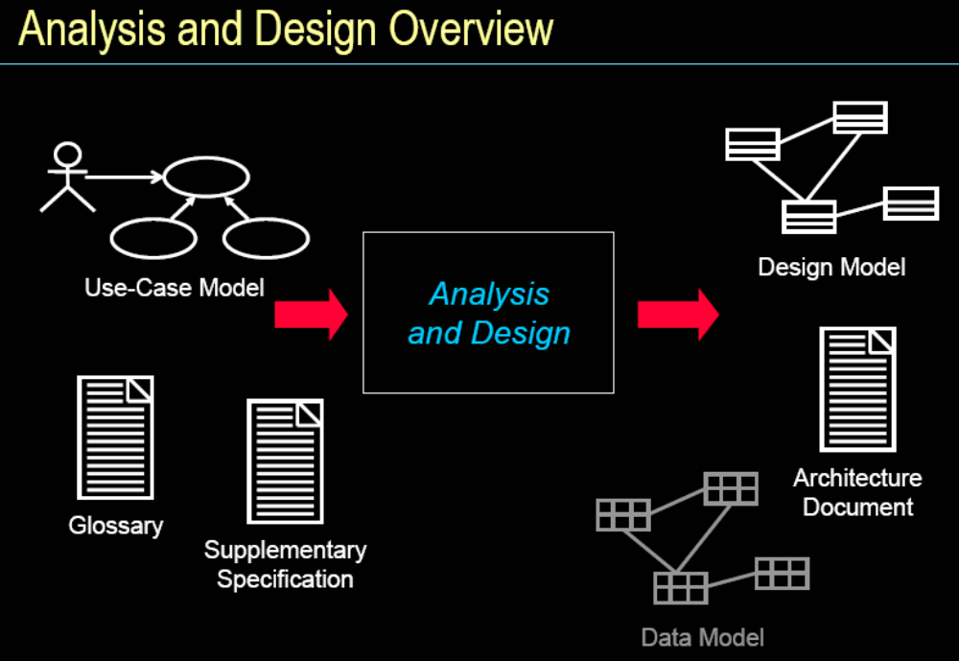

Slide 56
Outline
Introduction to RUP
Implementing Best Practices
Phases, Iterations, Workflows and Activities
The Iteration Process in RUP
Planning a RUP Project
Tailoring and Implementing RUP
RUP vs. CMMI

Slide 57
Goals and Features of Each Iteration
Each iteration is risk-driven
  performance risks
  integration risks (different vendors, tools, etc.)
  conceptual risks (ferret out analysis and design flaws)
Perform a “mini-waterfall” project
  Ends with a delivery of something tangible in code, available for scrutiny by the interested parties
  The result of a single iteration is an increment

Slide 58
Use Cases Drive the Iteration Process
Inception
Elaboration
Construction
Transition
Iteration 1
Iteration 2
Iteration 3
“Mini-Waterfall” Process
Iteration Planning
Rqmts Capture
Analysis & Design
Implementation
Test
Prepare Release

Slide 59
The Iteration Life Cycle: A Mini-Waterfall
Results of previous iterations
Up-to-date risk assessment
Controlled libraries of models, code, and tests
Selected scenarios
Iteration Planning
Requirements Capture
Analysis & Design
Implementation
Test
Prepare Release
Release description
Updated risk assessment
Controlled libraries

Slide 60
Iteration Assessment
Iteration N Cost and
Schedule Actuals
Iteration N Assessment
Revised Risk List
Compare iteration actual cost, schedule, and content with iteration plan
Determine rework (if any) to be done
  Assign to future iteration(s)
Determine what risks have been eliminated, reduced, or newly identified in this iteration
Update project plan
Prepare detailed plan for next iteration
  Use revised risk list and select appropriate scenarios
Revised Project Plan
Total Cost
Overall Schedule
Scope/Content
Quality Assessment
for Iteration N
Test Results
Defect Density
Architecture Stability
Other metrics
Iteration N+1 Plan
Cost
Schedule
Content

Slide 61
Selecting Iterations
In practice, iterations will vary slightly in focus and content across the iterative lifecycle
  Early iterations focus primarily on exploring ideas, consolidating requirements, putting the architecture in place, and getting feedback from stakeholder(s),
  Later iterations focus on making the software product complete and robust.

Slide 62
Selecting Iterations
How many iterations do I need?
  On projects taking 18 months or less, 3 to 6 iterations are typical
Are all iterations on a project the same length?
  Usually
  Iteration length may vary by phase. For example, elaboration iterations may be shorter than construction iterations

Slide 63
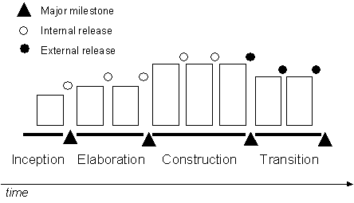
"Typical" RUP Iterations [1, 2, 3, 2]

Slide 64
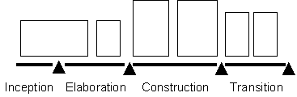
Iterative Lifecycle [0, 2, 2, 2]
If there is no need to explore feasibility, and if the scoping is easy to do, then maybe there is no real iteration in Inception

Slide 65
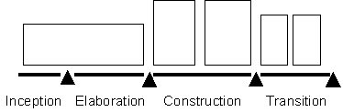
Iterative Lifecycle [0, 1, 2, 2]
If the architecture already exists, and the requirements are stable and well understood, then there may be few or no iterations in Elaboration

Slide 66
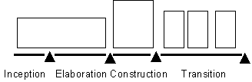
Iterative Lifecycle [0, 1, 1, 3+]
If the product is stable early on and has a solid foundation (architecture), an incremental delivery scheme can be introduced with several deliveries in the Transition phase that provide increasing functionality

Slide 67

Waterfall "Iterative" Lifecycle [0, 0, 0, 1]
And ultimately, the waterfall lifecycle can be described as an iterative lifecycle with only one iteration

Slide 68
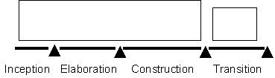
A More Likely Waterfall "Iterative" Lifecycle [0, 0, 1, 1]
There is one iteration to do the job up to the beta release or field trial, and a small iteration to clean up whatever needs to be fixed, completed, or changed

Slide 69
There Is No Silver Bullet
Main reason for using the iterative life cycle:
  You do not have all the information you need up front
  Things will change during the development period
You must expect that
  Some risks will not be eliminated as planned
  You will discover new risks along the way
  Some rework will be required; some lines of code developed for an iteration will be thrown away
  Requirements will change along the way

Slide 70
When To Sign a Contract
The ideal point in time
  waterfall: when the requirements are all captured, reviewed, approved, and frozen, and top-level design is mostly done
  RUP: at the end of the Elaboration phase
But often this is considered too late:
  So the alternative is at the end of the Inception phase

Slide 71
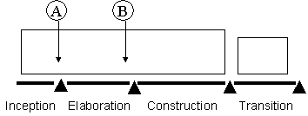
When To Sign a Contract
From a risk management perspective, an unprecedented project (or a project with a large amount of risks) do this in two steps, if the customer is amenable to this variation
a limited first contract at the end of Inception, to cover all the activities of Elaboration, and
a second, firm fixed price contract at the end of Elaboration to cover the rest of development

Slide 72
RUP的特点
特点：
  用例驱动、以架构为中心、迭代和增量；
优点：
  具有二维迭代性，有利于降低风险、适应需求变化；
  是可配置的，具有通用性；
缺点：
  是在理想的项目开发环境下软件过程的一种完美模式；
  未给出具体的剪裁、扩充等配置实施的方法准则。

Slide 73
Outline
Introduction to RUP
Implementing Best Practices
Phases, Iterations, Workflows and Activities
The Iteration Process in RUP
Planning a RUP Project
Tailoring and Implementing RUP
RUP vs. CMMI

Slide 74
How to Develop a Project Plan
RUP clearly distinguishes between project planning and planning for a specific iteration.
  A coarse-grained plan for the entire project
    Define the phase milestones, the number of iterations, and the overall project size estimates.
  A fine-grained plan for each iteration
    Define iteration-specific items such as deliverables, iteration length, risks to be mitigated, activities, assignment of responsibilities, and measurement criteria.

Slide 75
Perform Project Start Activities
Developing a Business Case
  Determining the Economic viability of the project
Identifying and Assessing Risks
Initiating the Project
  Sets up the necessary executive management and project planning teams (if applicable), and also sets out the criteria that will be used to determine when the project has been successfully completed.

Slide 76
Define the Project Organization and Staffing
Defines the project organization based on the characteristics of the project and external constraints, such as existing organizational policy.
  Defining the organizational structure of the project in terms of positions, teams, responsibilities, and hierarchy.
Defines staffing requirements based on the effort estimates for the project, the desired schedule, the chosen organizational structure, and mapping of roles.
  Defining the numbers, type (skills, domain), experience, and caliber of staff required for the project.
  Adjusting the software development team from its baseline as your project moves through its development lifecycle.

Slide 77
Compile the Software Development Plan (SDP)
Defining the Project Structure
  RUP provides key questions whose answers will shed light on the number of iterations required in each phase of your project and the time and effort required for each phase.
Estimating Project Size
  Very difficult…

Slide 78
How to Develop Iteration Plans
Once the project manager has completed the coarse-grained project plan, she or he develops an iteration plan at a more detailed level before every iteration.
Each iteration in a phase moves the project toward the phase milestones, and iteration plans are the mechanism by which this movement happens.
An iteration plan defines a clear objective and associates with it the activities required to accomplish that objective.

Slide 79
Consider What Phase You’re In
The phase you’re in helps determine the objective of your particular iteration.
The factors defined earlier in the planning process will help the manager determine which of these objectives to focus on.
Each of these objectives is associated with a deliverable.

Slide 80
Determine the Deliverable(s)
A deliverable may be something like a vision (of the system) or a series of use cases.
  Produced during that iteration
Each deliverable has associated with it a workflow template identifying the activities, resources, and other deliverables that will be required to complete this deliverable.
It also has associated with it an artifact, meaning the documentation that the project produces for that deliverable and that can be used to review the deliverable at the end of the iteration or workflow.

Slide 81
Select the Appropriate Workflow Template
For each deliverable, there’s an associated workflow template in the RUP that identifies the activities required to realize this deliverable.
  An activity includes roles, artifacts, and guidance (help steps).
  Certain activities may not be appropriate for your particular project or iteration , and these can be omitted.
  The amount of time allowed for activities will depend on the total time allocated for this iteration in the project plan.

Slide 82
Associate Resources with Activities
Resources need to be associated with each particular activity in the iteration plan.
The workflow template provides hints as to which resources are required by defining the roles that need to be played in each activity.
The planner must fill the roles with actual workers.

Slide 83
Define Monitoring and Control Processes
How do you know when your project is off track? What do you do to get a wayward project back on course?
To answer these questions, the project manager needs monitoring and control processes that check vital signs of the project with regard to the software development plan.
Typically, the project manager will be concerned with indicators that apply to the project’s scope of work, progress, budget, quality, and risks.

Slide 84
Outline
Introduction to RUP
Implementing Best Practices
Phases, Iterations, Workflows and Activities
The Iteration Process in RUP
Planning a RUP Project
Tailoring and Implementing RUP
RUP vs. CMMI

Slide 85
RUP Has …
4 Phases
9 Core Workflows
31 Roles/Workers
103 Artifacts
136 Activities
15 Tool Mentors
14 Work Guidelines
43 Word/HTML Templates
8 Project Plan Templates
…

Slide 86
Are you Overwhelmed Yet?
The answer is Tailoring
As you sort through the many artifacts, activities and roles in the RUP, you may ask yourself:
  “Do I need this one?”
  “How do I sort through all of these items to determine which ones I need for my project?”
  “Isn’t it obvious that the RUP is only for big projects?”

Slide 87
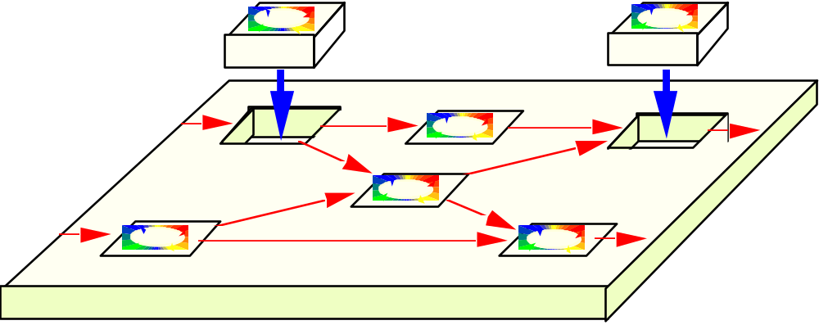
Rational Unified Process: Tailorable
Use in whole or in part
Tailor by creating a project-specific or organization-specific “Development Case”
Development kit - guidelines, tools and templates for customizing the process

Slide 88
Development Case
A development case is a static configuration of the RUP; that is, it's tailored to a specific project, product, and organization.
  Focuses on what to do and how to do it.
  Provides an overview of the process to be followed, something understood by everyone on the project. For details, the development case should refer to the RUP and other guidelines or style-guides.

Slide 89
Tailoring: Build a Framework
Do not include activities and artifacts that cannot be clearly justified
Shield your developers from the process
Minimize formal intermediate artifacts

Slide 90
Tailoring: Use Convenient Formats
Generate when possible
Use the Web
Use integrated tools

Slide 91
Tailoring: Regularly Revisit the Process
Regularly revisit the process to refine and reduce its complexity.
  If your staff isn't convinced that each step in the process provides added value for the end product, then the process is probably broken.
Tailor while retaining best practices.

Slide 92
Reduce the Ceremony
We don’t want methodology priests
We don’t want a methodology board that must approve all artifacts
We don’t want to produce any paper if possible

Slide 93
The Ten Essentials of RUP
1. Develop a Vision
2. Manage to the Plan
3. Identify and Mitigate Risks
4. Assign and Track Issues
5. Examine the Business Case
6. Design a Component Architecture
7. Incrementally Build and Test the Product
8. Verify and Evaluate Results
9. Manage and Control Changes
10. Provide User Support
“Ten Essentials” list is meant only as a starting point for further discussion!

Slide 94
Implementing RUP - The Interactive Knowledgebase...
Limited training
Decide what artifacts to produce
Look at the process when you need help producing the artifacts
Benefits increases over time as people start following the process…
Easy to adopt

Slide 95
Implementing RUP : The Full Scale Adoption…
Radical Improvements
“Members become
Mentors”
Further train and mentor each project
Large Project 3
Evaluate
Pilot
Large Project 2
Pilot Project
Large Project 1
Feed-back
Define and
Test a specific
Development Case
Establish
Process and
Support Environment
Development
Case
3-6 months
1 month
1-2 years

Slide 96
Suggestions about Implementation
First Do No Harm
Have onsite Process Mentors
Have people who are good at process design do the process design
Pilot Pieces of the Process
Have a Sales Mentality
Look for Allies
Have Patience and Stamina
…

Slide 97
How to Fail with RUP !!
Step 1: Superimpose “Waterfall” Thinking
  Superimpose Waterfall Phases on the RUP Phases
  Define Iterations Too Long or Too Short
  Polish the Requirements before Design
  Expect Believable Estimates and Detailed Plans Near the Start of a Project
Step 2: Apply the RUP as a Heavy, Predictive Process
Step 3: Avoid Object Technology Skills

Slide 98
How to Fail with RUP !! (cons.)
Step 4: Undervalue Adaptive Iterative Development
  Embrace Rigid and Predictive Attitudes
  Pervert the Practice of Iterative Development
  Don’t Educate Stakeholders in the Implications of Iterative Development
  Over-Model and Create Many Low-Value Artifacts
Step 5: Avoid Mentors Who Understand Iterative Development
Step 6: Adopt the RUP in a Big Bang
Step 7: Take Advice from Misinformed Sources

Slide 99
Outline
Introduction to RUP
Implementing Best Practices
Phases, Iterations, Workflows and Activities
The Iteration Process in RUP
Planning a RUP Project
Tailoring and Implementing RUP
RUP vs. CMMI

Slide 100
Level of Abstraction
Software Process Capability Models
What
CMMI
Software Life Cycle Models
MSF
3W1H
Software Process
RUP

Slide 101
Software Process Capability Models
A capability model is not a process, but a framework for designing, evaluating and improving processes.
In order to maximize their applicability, capability models are designed to be domain and life cycle independent.
  They define work products and specific activities, but only in an abstract sense.
  Selecting a capability model does not define a process; it is only a first step toward designing one.

Slide 102
Differences between CMMI and RUP
CMMI provides good guidance on general systems development practices and institutionalization of process practices
RUP provides strong engineering, basic support, and basic project management practices
Organizations using RUP may have need to address
  Statistical process control
  Organizational process elements
  Subcontractor or vendor management practices
  Institutionalization of processes

Slide 103
Using RUP to Satisfy CMMI Level 2
RUP is valuable framework for satisfying many of the CMMI’s maturity level 2 goals.
  Requirements - CMMI Requirements Management PA
  Project Management - CMMI Project Planning PA, Project Monitoring & Control PA, Process and Product Quality Assurance PA, Measurement and Analysis PA
  Configuration & Change Management - CMMI Configuration Management PA, Measurement & Analysis PA
  Test - Measurement and Analysis PA
The Environment discipline applies to several of the generic practices at CMMI maturity level 2.
The activity Develop Development Case specifically addresses GP 2.2 Plan the Process practice by asking projects to tailor RUP to meet their specific requirements.

Slide 104
Using RUP to Satisfy CMMI Level 2
To fully satisfy CMMI goals, some additional activities must be performed that aren’t specifically called out by RUP:
  Creation of organizational policies that direct the planning and performing of CMMI ML 2 processes
  Creation of detailed standards and procedures that address the day-to-day performance of all system and software engineering activities
  Process-oriented reviews
  Managing suppliers

Slide 105
CMMI Level 2&3 Acceleration
By adopting RUP, an organization can shortcut the need to internally develop and document several of the required software development processes.
Since the focus of CMMI Level 3 is the organization instead of the project, successful implementation of RUP will significantly reduce the time required to achieve CMMI Level 3
Document As-is Processes
Improve Processes
Institutionalize Processes
Achieve CMMI Level 2
time

